Slide 1

Climate Change Challenge: QUIZ!
Notes:
Climate Centre was established in 2002 and became and independent foundation in 2004. We can be seen as a knowledge or a reference centre to the whole RC/RC Movement.

Slide 2
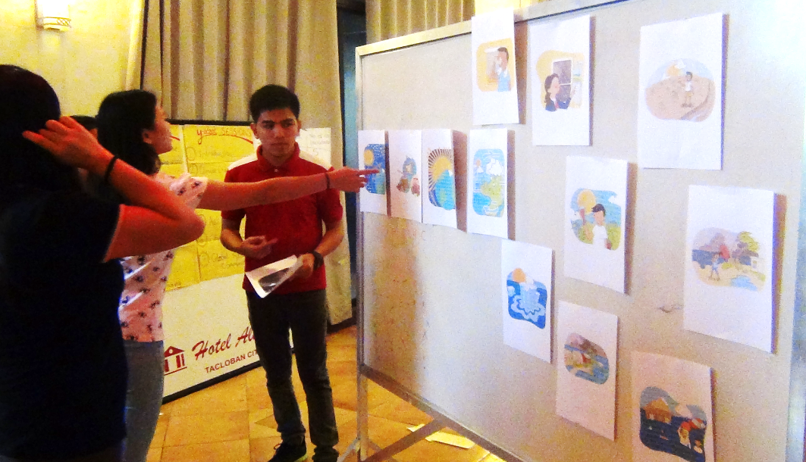
Real world goals
Test your understanding of climate change science
Support to debrief Y-Adapt ‘Climate Change Challenge’
Learn more and share knowledge

Slide 3

Quiz teams!
5 – 8 players per team
Choose an original and relevant name!
Bonus point for the best team name

Slide 4
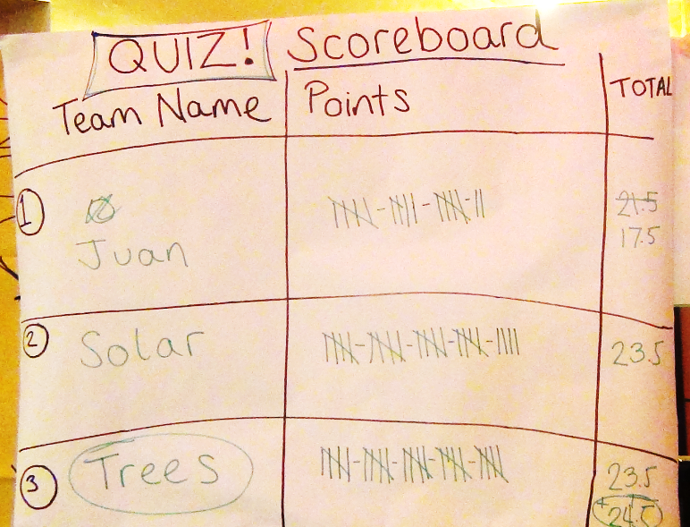
Scorekeeper

Slide 5
Rules
Two minutes maximum to answer a question
If it is answered correctly, the team gets a point
If the team answers incorrectly or it takes too long, the next team gets a chance to answer
Each team needs a pen and paper
The team with most points wins the prize!

Slide 6

Ready?!
We’ll start with a question for all the teams…
Raise your hand and shout your team name when you’re ready to answer
The first team to give the correct answer wins a point!
Match the following terms with the correct definitions…

Slide 7
Match the term with the definition
Term
Definition
Weather
Climate
Climate change
Refers to average weather conditions over a long period of time (30+ years).
Refers to conditions like rain, temperature and wind over hours to days.
Refers to a statistically significant change in the state of the climate (or average weather) that persists for an extended period of time (decades or longer).

Slide 8
The answer is…
Weather | Climate | Climate Change
Refers to conditions like rain, temperature and wind over hours to days. | Refers to average weather conditions over a long period of time (30+ years). | Refers to a statistically significant change in the state of the climate (or average weather) that persists for an extended period of time (decades or longer).
The difference is in the timescale!

Slide 9

Now a question for Team One only…
You have two minutes maximum to answer!

Slide 10
Sunlight passes in through the atmosphere, but greenhouse gases prevent it escaping back out. This traps heat in the atmosphere
What do we call this process?
Global dimming
Air pollution build-up
The greenhouse effect
Atmospheric thickening

Slide 11
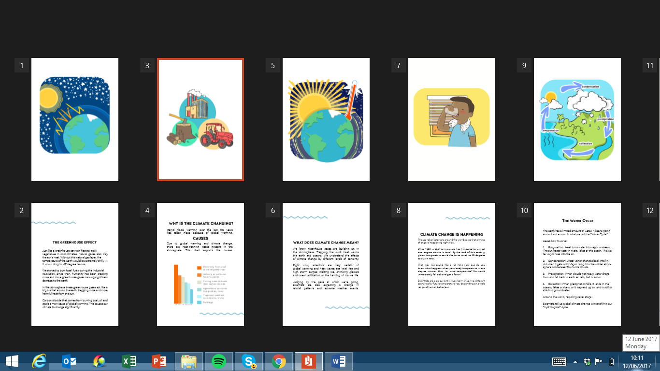
The answer is C!
Global dimming
Air pollution build-up
The greenhouse effect
Atmospheric thickening
Notes:
Refers to process described in previous slide.
11

Slide 12
Do greenhouse gases occur naturally in the atmosphere?
Yes: A certain amount of greenhouse gases occur naturally in the atmosphere
No: Greenhouse gases do not occur naturally. All greenhouse gases in the atmosphere are produced by human activities

Slide 13
The answer is yes…
Yes: A small amount of greenhouse gases occur naturally in the atmosphere
When the sun’s rays are reflected from the earth, naturally occurring greenhouse gases can trap reflected heat in the atmosphere. Without this, the earth would be very cold – about minus 18 degrees Celsius! All water on earth would freeze, the oceans would turn to ice and life as we know it would not exist

Slide 14
Over the last 100 years the planet has been warming up, called Global Warming. Why is it warming?
The sun is getting closer and hotter as part of a natural sun cycle
Greenhouse gases are building up in the atmosphere, preventing more heat from the sun escaping back out into space
C. Scientists do not know why the earth is warming up, they just know that it is
Notes:
Answer B.
The whole in the ozone layer is a different problem, with different causes and solutions (although some greenhouse gases also are bad for the ozone layer). The affects of the whole in the ozone layer are more localized as opposed to global. The Montreal Protocol regulates gases that deplete the ozone layer, so this issue is still important, but in many ways is being addressed.

Slide 15
The Answer is B…
Over the last 100 years, since the industrial revolution, greenhouse gases have been rapidly increasing in the atmosphere.
This is because of human activities which release greenhouse gases into the atmosphere
More greenhouse gases trap more heat leading to GLOBAL WARMING

Slide 16
Which two activities are the biggest cause of increased greenhouse gas in the atmosphere?
i) Electricity from coal or diesel generators and (ii) Industry or pollution from factories
i) Cutting trees which releases their carbon dioxide and (ii) Transportation
C. i) Agricultural practices and (ii) Buildings

Slide 17
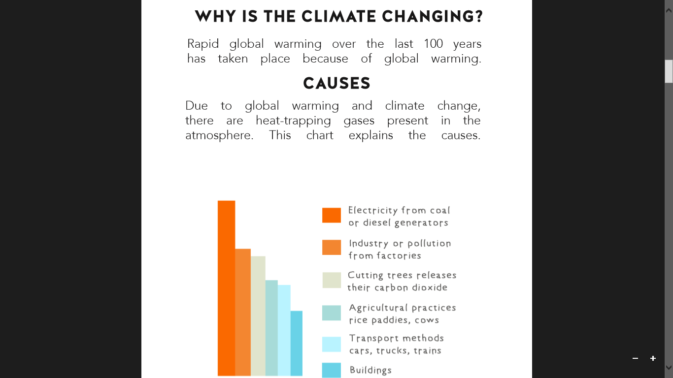
The answer is A!
A. i) Electricity from coal or diesel generators and (ii) Industry or pollution from factories
The main human activities releasing greenhouse gas into the atmosphere:

Slide 18

All teams challenge!
All teams play!
Pens and paper ready…
Two minutes to answer the following…

Slide 19
How many different greenhouse gases can you name?
One point for each correctly named greenhouse gas
CLUE: There are five major types of greenhouse gas

Slide 20
The major greenhouse gases are:
Carbon dioxide
Methane
Nitrous oxide
Fluorinated gases
Water vapour

Slide 21
If we stopped all greenhouse gas emissions today, would we still have climate change?
No, the greenhouse gases in the atmosphere would quickly dissipate, immediately stopping the warming and related changes in the climate
Yes, humans have been adding greenhouse gases to the atmosphere for so many years now, that even if all emissions stopped today, the planet would still continue to warm for decades to come

Slide 22
The answer is yes…
No, the greenhouse gases in the atmosphere would quickly dissipate, immediately stopping the warming and related changes in the climate.
Yes, humans have been adding greenhouse gases to the atmosphere for so many years now, that even if all emissions stopped today, the planet would still continue to warm for decades to come.
Notes:
Answer: Yes
However, dramatically reducing our emissions is still critical in order to prevent run-away climate change and to keep climate risks manageable.

Slide 23
How is global warming effecting the water cycle and climate system?
Higher temperatures increase evaporation of water from sea, lakes, rivers
Warmer air holds more water vapour. This results in more intense rainstorms, which can lead to flooding
More floods where water runs off into rivers and streams, does little to dampen the soil. This and increased temperatures can lead to drought
All of the above

Slide 24
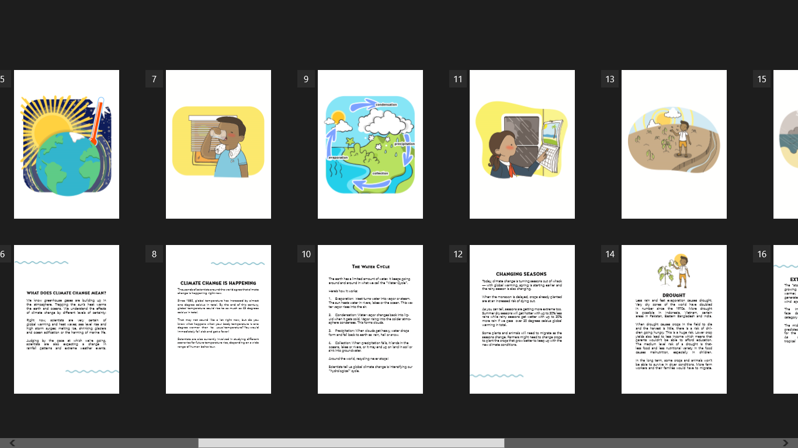
The answer is D…
All of the above
Global warming intensifies the water cycle
This leads to intense rainstorms and flooding, as well as drought
Weather patterns across the world are effected over time
This results in CLIMATE CHANGE

Slide 25
If we experience an extreme weather event, can we attribute that specific event to climate change?
Yes, climate change will bring more extreme weather events, so we can attribute individual events to climate change
No, because weather fluctuates on short-term timescales and climate change is occurring over a much longer timescale

Slide 26
The answer is complex…
We CAN’T anecdotally say that any extreme weather event was caused by climate change
But you CAN do an attribution study and say that the event was made more likely / more intense due to climate change

Slide 27
All teams challenge!
All teams play!
Pens and paper ready…
Two minutes to answer the following…

Slide 28
Climate change is exacerbating weather related events and hazards over time.
Which hazards are projected to increase due to climate change?
Two minutes to list as many as you can
One point for each correct answer

Slide 29
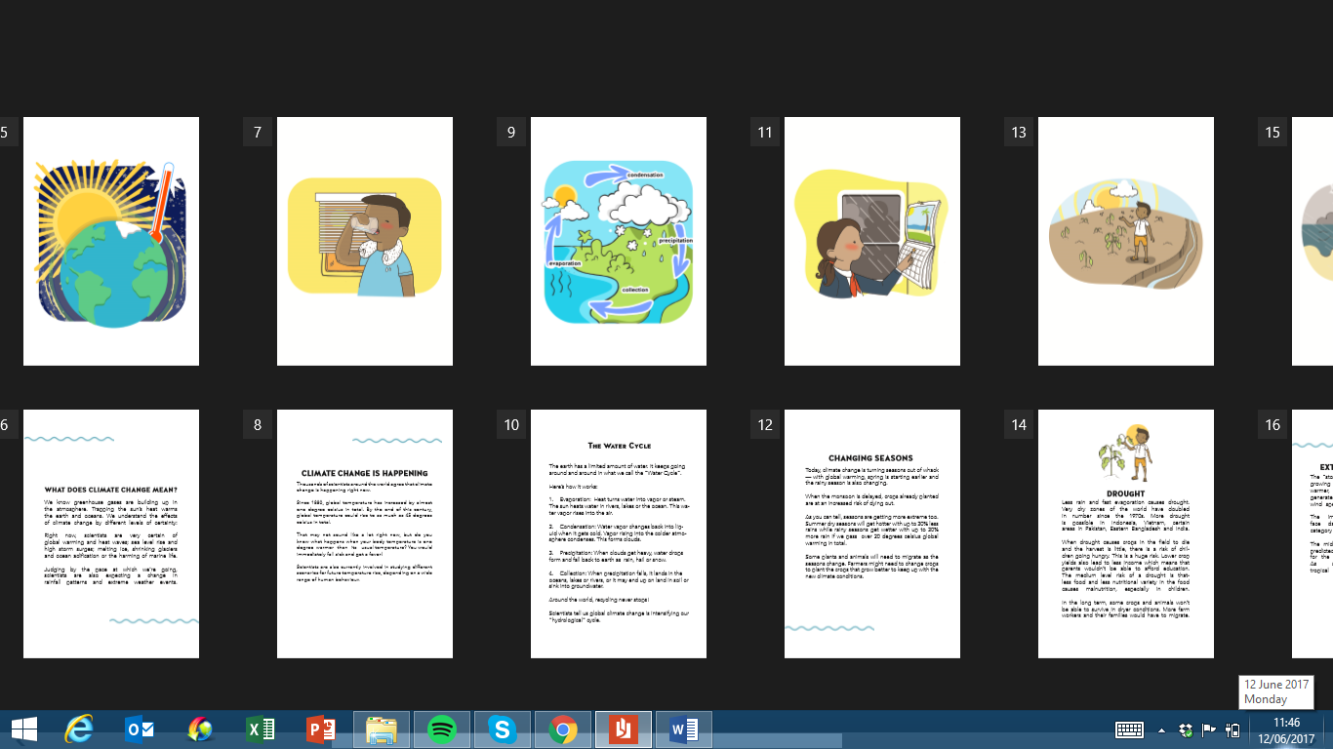
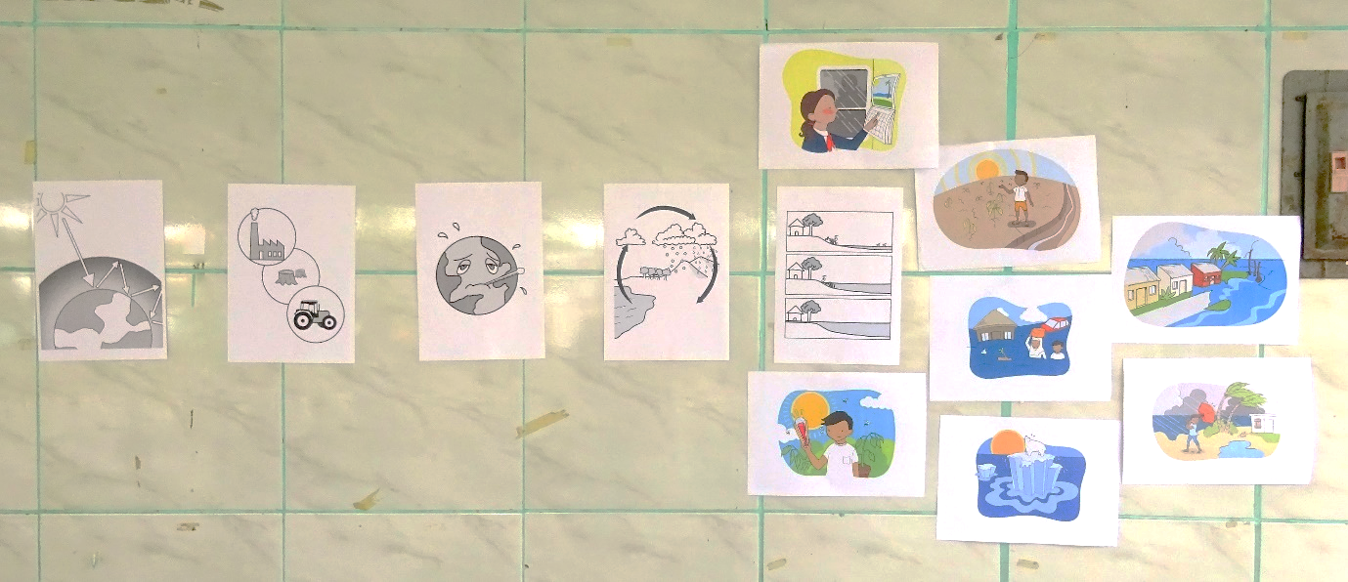
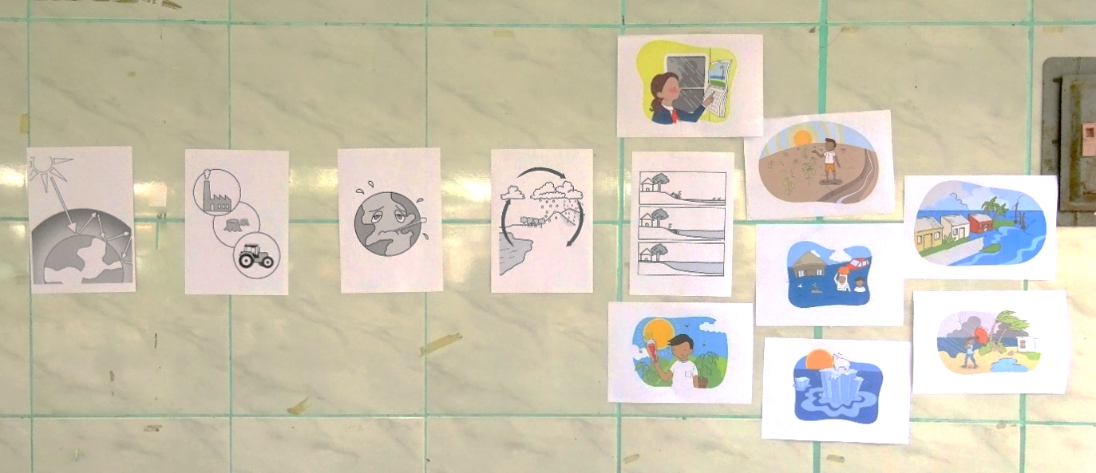

Scientists project:
Temperature increase (0.3 – 4.8°C by 2100)
Heat waves - more often and last longer
Extreme precipitation events (rain, snow) - more often and more intense
Precipitation increases in wet regions
Precipitation decreases in dry regions
Increase in tropical cyclone wind speeds
Decreased snow / ice extent
Rising sea level
Warming and acidification of oceans
Source: IPCC 2014, AR5
Notes:
Temperature increase range shows projected increase of global mean surface temperature by the end of the 21st century (2081–2100) relative to 1986–2005, depending on how much greenhouse gas emissions are reduced

Slide 30
If we know the climate change projections for 2100, do we need to pay attention to forecasts on shorter timescales?
Yes, because between now and 2100 natural climate variability and weather could bring conditions / events that are different from the long-term projections
No, for example, if the climate change projection is for drought in 2100, we know that we will gradually experience drying over the next century, so we just need to focus on drought-preparedness and water resource management

Slide 31
The answer is Yes!
Yes, because between now and 2100 natural climate variability and weather could bring conditions / events that are different from the long-term projections
No, for example, if the climate change projection is for drought in 2100, we know that we will gradually experience drying over the next century, so we just need to focus on drought-preparedness and water resource management

Slide 32
What is the definition of
Climate Change Adaptation?
A. Action taken to deal with climate change impacts and reduce the effects on lives, livelihoods and ecosystems
B. Action taken to stop climate change by reducing the amount of greenhouse gasses in the atmosphere.
Notes:
32

Slide 33
The answer is A!
A. Climate Change Adaptation: Action taken to deal with climate change impacts and reduce the effects on lives, livelihoods and ecosystems
B. Climate Change Mitigation: Action taken to stop climate change by reducing the amount of greenhouse gasses in the atmosphere
Notes:
33

Slide 34
Bonus question!
First team to raise their hand and shout their team name gets to answer the question

Slide 35
What type of actions does Y-Adapt focus on?
Youth-led actions to deal with the impacts of climate change
Youth-led actions to stop climate change from happening
BONUS POINT! Can you give an example?

Slide 36
Y-Adapt focuses on A..
Youth-led actions to deal with the impacts of climate change
We call this youth led Climate Change Adaptation
ANY EXAMPLES?

Slide 37
Let’s tally the points…
CONGRATULATIONS!
Winning team, you get a prize!
Everybody else, we hope you had fun whilst learning ☺ Maybe the winning team will share their prize with you…

Slide 38
References
IPCC (2014) AR5 Synthesis Report; https://www.ipcc.ch/pdf/assessment-report/ar5/syr/SYR_AR5_FINAL_full.pdf
IPCC WGII (2014) Climate Change and the Ocean; https://www.ipcc.ch/report/ar5/wg2/docs/WGII-AR5_Oceans-Compendium.pdf
Image accreditations
Raise Your Hand By Ahmed Sagarwala, CA, the Noun Project
Stopwatch by Musket, the Noun project
Pen and paper by Creative Stall from the Noun Project
Y-Adapt images

